Slide 1
I/O: Input and Output

Slide 2
Text
A string of characters is said to be of mode character.
Character strings are denoted by either double quotes " " or single quotes ' '.
Strings can be arranged into vectors and matrices just like numbers.
We can paste string using paste(…, sep).
> x <- "Citroen SM"
> y <- "Jaguar XK150"
> z <- "Ford Falcon GT-HO"
> (wish.list <- paste(x, y, z, sep=", "))
[1] "Citroen SM, Jaguar XK150, Ford Falcon GT-HO"

Slide 3
more about characters
Special characters with the escape character \.
\n for newline, \t for tab, \b for backspace, \" for ", \\ for \
If a character string can be understood as a number, the as.numeric(x) is used.
> as.numeric("10.1") [1] 10.1
Use as.character(x) to coerce a number into a character string.
> as.character(10.1) [1] "10.1"

Slide 4
Input from a file
R provides a number of ways to read data from a file.
scan function is the most flexible one.
scan to read a vector of values from a file.
scan(file= "", what=0, n=-1, sep="", skip=0, quiet=FALSE)
all parameters are optional
file gives the file to read from.
The default " " indicates read from the keyboard.
what gives an example of the mode of data to be read.
use 0 for numeric value, use " " for character data.
n gives the number of elements to read.
if n = -1 then scan keeps reading until EOF.
sep allows you to specify that is used to separate values such as ","
skip is the number of lines to skip before start reading.
quiet controls whether or not scan reports how may values it has read.

Slide 5
Example : file input
# You need to change the path of the file accordingly.
data <- scan(file="C:/Code/R/simulation/data1.txt") n <- length(data) data.sort <- sort(data) data.1qrt <- data.sort[ceiling(n/4)] data.med <- data.sort[ceiling(n/2)] data.3qrt <- data.sort[ceiling(3*n/4)] cat("1st Quartile:", data.1qrt, "\n") cat("Median: ", data.med, "\n") cat("3rd Quartile:", data.3qrt, "\n")

Slide 6
Example : file input(2)
By using the built-in function quantile
> quantile( scan("C:/Code/R/simulation/data1.txt"), (0:4)/4 )
0% 25% 50% 75% 100%
0.00 2.25 4.50 6.75 9.00

Slide 7
Input from the keyboard
scan can be used to read from the keyboard if file is "".
> scan(file="", what="") # character input > scan(file="", what=0) # numeric input
readline(prompt) read a single line of text from the keyboard.
prompt (default "") : takes the optional character input
> your_name <- readline("Input your name : ")

Slide 8

Example : Root of quadratic
cat("find zeros of a2*x^2 +a1*x +a0 = 0\n")
a2 <- as.numeric(readline("a2= ")) a1 <- as.numeric(readline("a1= ")) a0 <- as.numeric(readline("a0= "))
discrim <- a1^2 - 4*a2*a0
if (discrim > 0) {
roots <- (-a1 + c(1,-1) * sqrt(a1^2 - 4*a2*a0))/(2*a2)
} else if (discrim == 0) {
roots <- -a1/(2*a2)
} else {
roots <- c() }
if (length(roots) == 0){
cat("no root\n")
} else if (length(roots)==1){
cat("single root at", roots, "\n")
} else{
cat("roots at", roots[1], "and", roots[2], "\n")
}
Save the source code and type
> source(" path of the source code ")
Or, in Rstudio, use

Slide 9
Output to a file
Generally use write or write.table for writing numeric
cat for writing text, or a combination of numeric and text.
write(x, file = "data", ncolumns = if(is.character(x)) 1 else 5, append = FALSE)
x is the vector to be written.
If x is a matrix then it is converted to a vector (column by column)
file gives the file to write as a character string
default "data" writes to a file called data in the current working directory
to write to the screen use file=""
ncolumns : the number of columns to write the data in.
append indicates whether to append to or overwrite the file.

Slide 10
write and matrix
write converts matrices to vectors
Since R stores its matrices by column, you should transpose the matrix to write if you want the output to reflect the matrix structure.
> ( x <- matrix(1:24, nrow=4, ncol=6))
> write(t(x), file = "out.txt", ncolumn=6)

Slide 11
cat for writing to a file
cat is more flexible command.
cat(…, file="", sep="", append=FALSE)
… is a list of expressions (separated by commas) that are coerced into character strings, concatenated, and then written.
file gives the file to write or append to as a character string.
the default "" writes to the screen.
sep is character string that is inserted between objects.
append indicates whether to append to or overwrite the file.

Slide 12
dump
dump creates a text representation of almost any object that can subsequently read by source.
> x <- matrix(rep(1:5, 1:5), nrow=3, ncol=5) > dump("x", file="result.txt") > rm(x) > source("result.txt") > x [,1] [,2] [,3] [,4] [,5] [1,] 1 3 4 4 5 [2,] 2 3 4 5 5 [3,] 2 3 4 5 5

Slide 13
Plotting
We have already seen plot(x, y, type).
To add points to the current plot, use points(x, y).
To add lines, use lines(x, y).
To add vertical or horizontal liens, use abline(v=xpos) or abline(y=ypos).
points and lines take optional input col, which determines color.
colors() show the complete list of colors.
To add text labels[1] at (x[i], y[i]), use text(x, y, lables).
pos is used to indicate the position. (See help(text))
title(main) for the title (main is a character string).

Slide 14
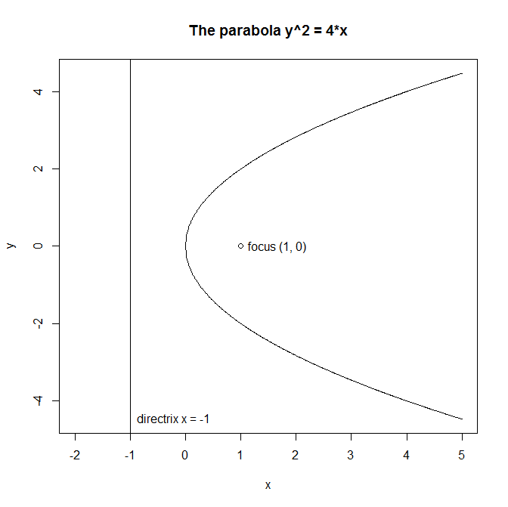

plotting a parabola $y^{2}=4x$
x <- seq(0, 5, by=0.01) y.upper <- 2*sqrt(x) y.lower <- -2*sqrt(x) y.max <- max(y.upper) y.min <- min(y.lower) plot(c(-2,5), c(y.min, y.max), type="n", xlab="x", ylab="y")
lines(x, y.upper) lines(x, y.lower) abline(v=-1) points(1,0) text(1, 0, "focus (1, 0)", pos=4) text(-1, y.min, "directrix x = -1", pos=4) title("The parabola y^2 = 4*x")

Slide 15
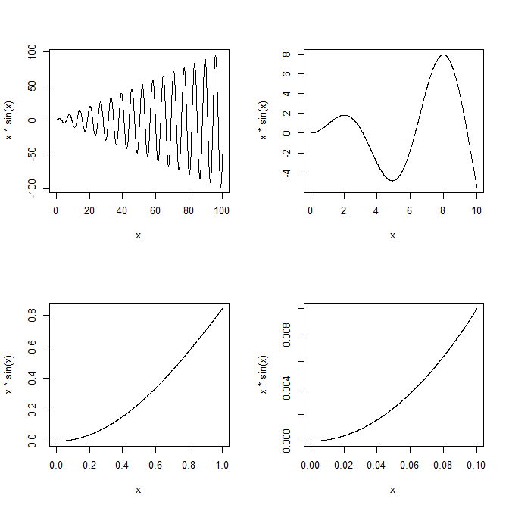
more than one plots
windows() open additional graphics devices.
par(mfrow = c(nr, nc)) or par(mfcol = c(nr, nc)) creates a grid of plots.
mfrow = c(nr, nc)) : with nr rows and nc columns, filled row by row.
mfcol = c(nr, nc)) : filled column by column.
> par(mfrow=c(2,2)) > curve(x*sin(x), from=0, to=100, n=1001) > curve(x*sin(x), from=0, to=10, n=1001) > curve(x*sin(x), from=0, to=1, n=1001) > curve(x*sin(x), from=0, to=0.1, n=1001)

